Slide 1


Slide 2
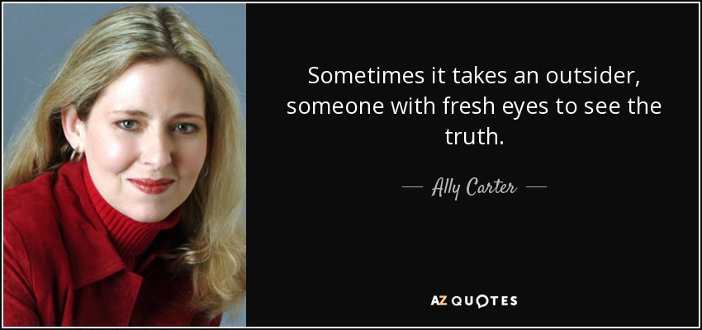

Slide 3


Slide 4
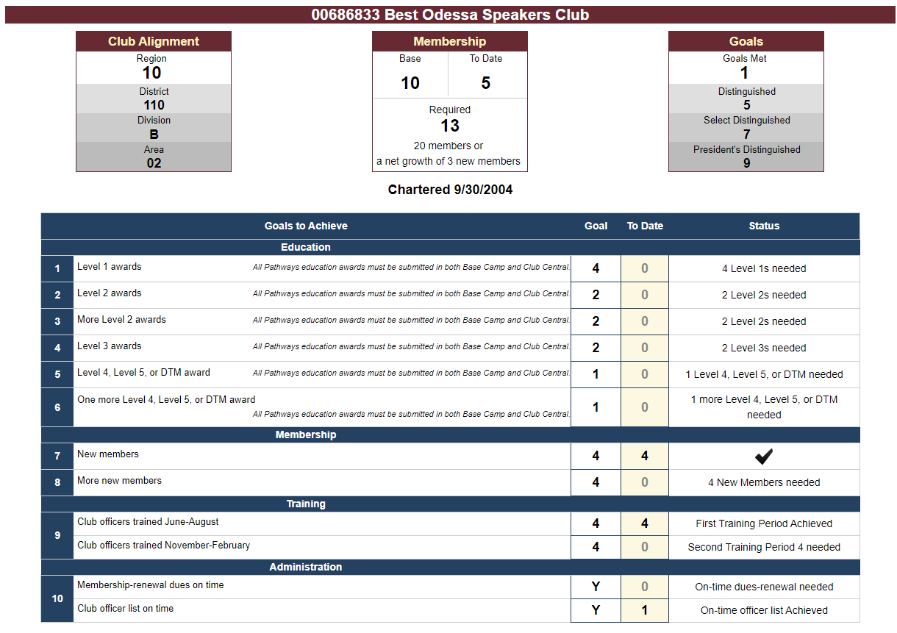

Slide 5




Slide 6
Most used chat application worldwide
WhatsApp Communities

Slide 7
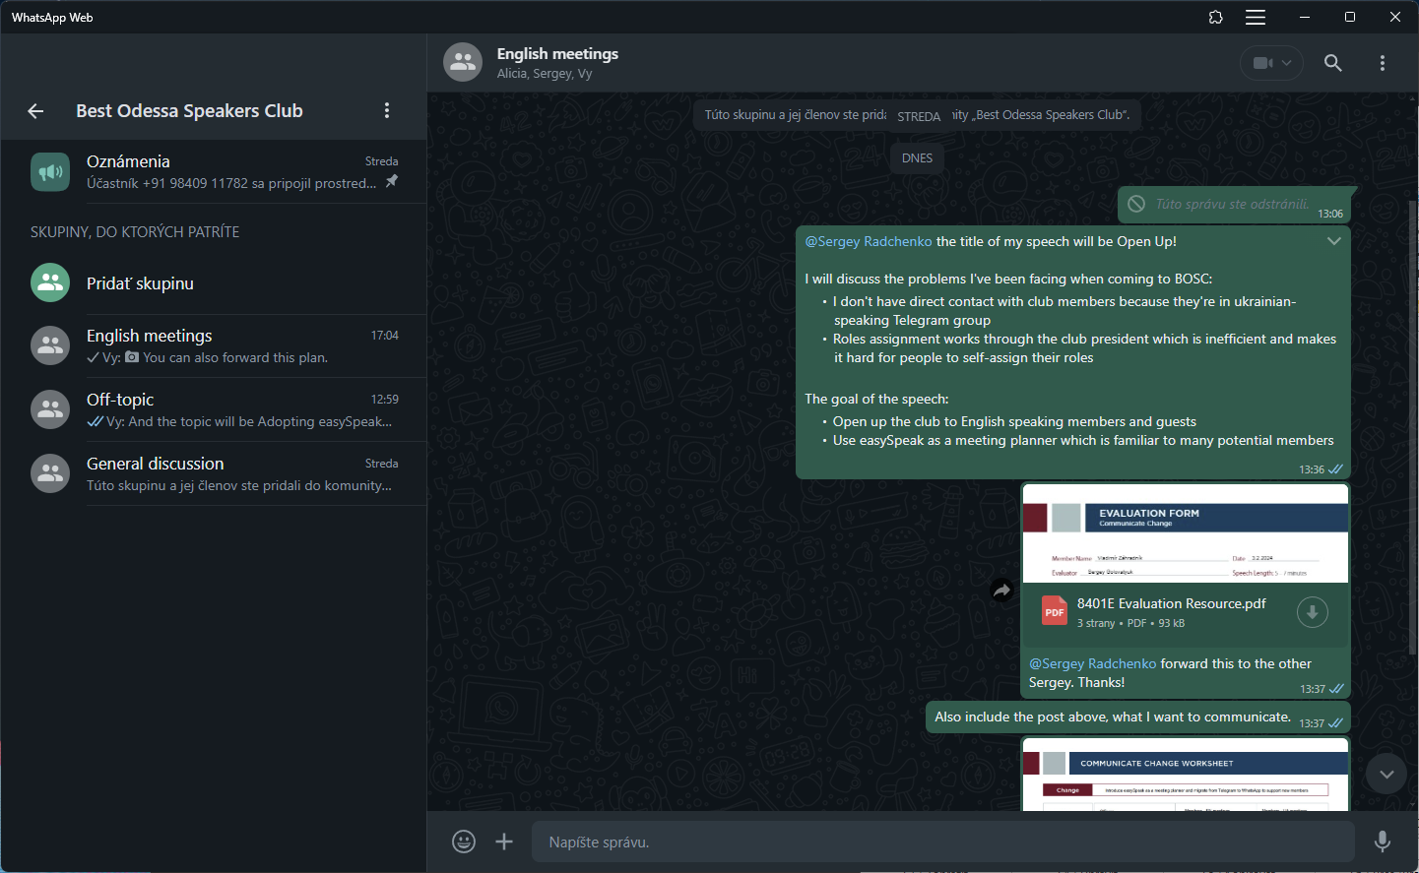

Slide 8
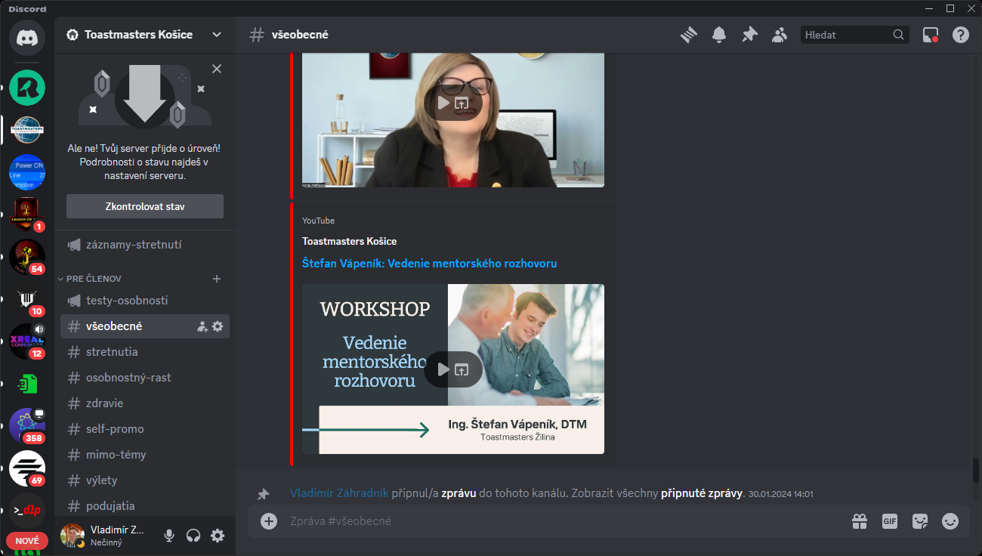

Slide 9
Used by almost 2000 clubs worldwide
Familiarity for our potential members
Easier meeting planning
Better insights about your education progress
Created by Toastmasters for Toastmasters

Slide 10
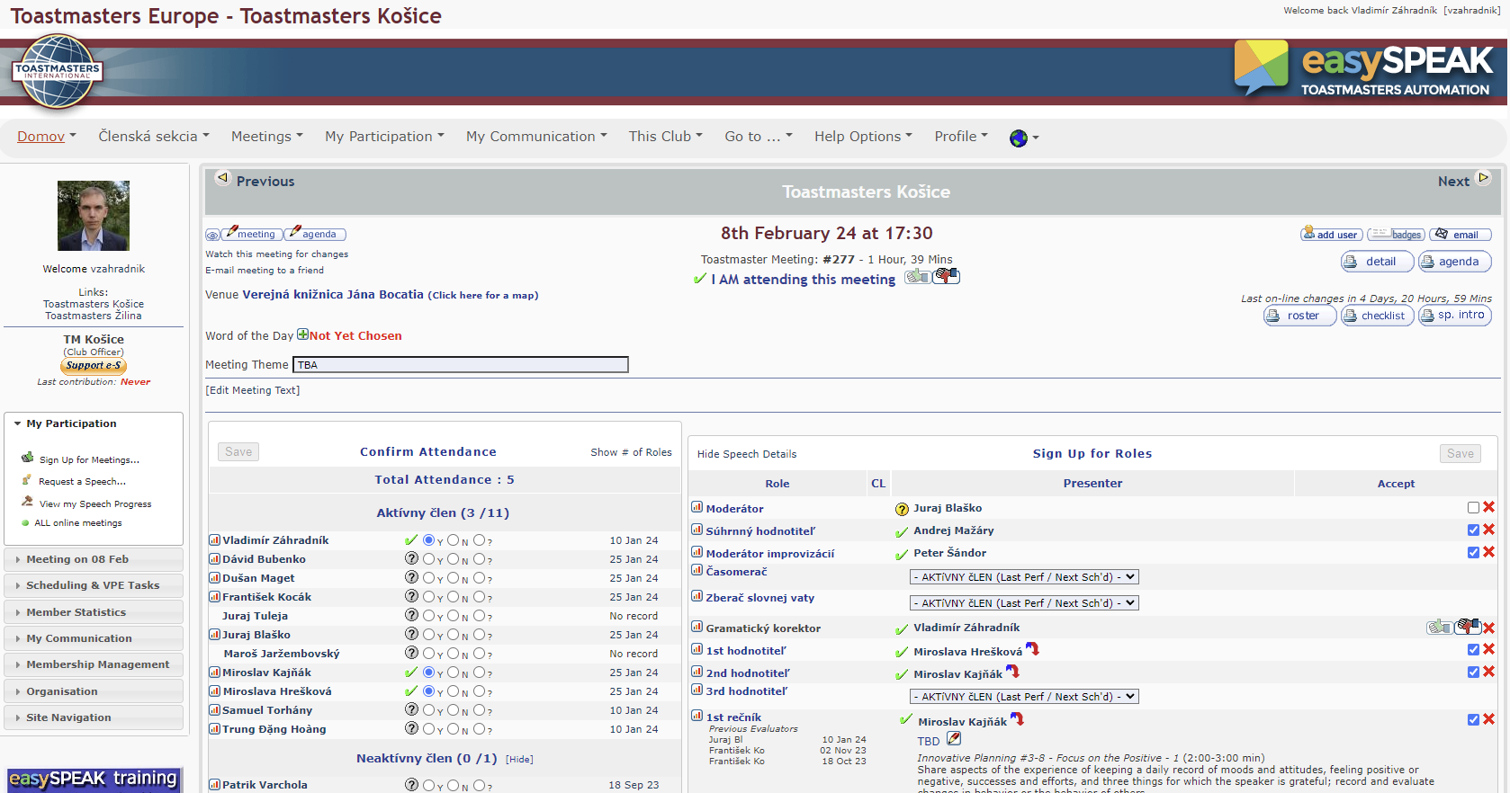

Slide 11
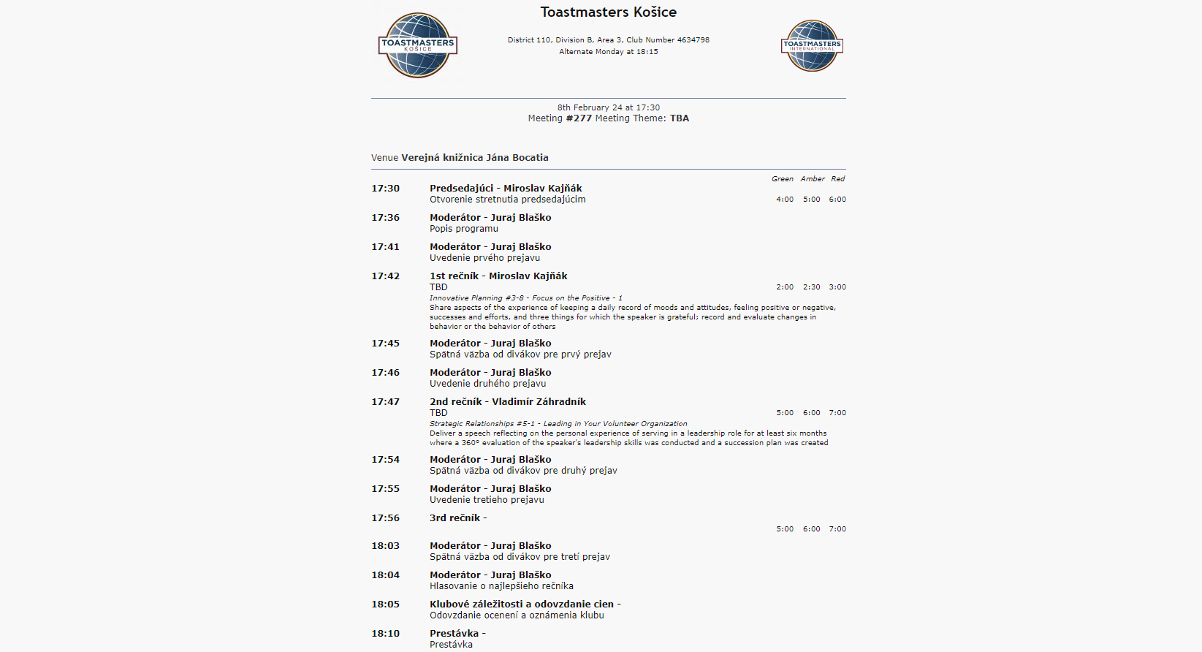

Slide 12

Workshop for club officers
Lets discuss together!

Slide 13

Thank You!

